Slide 1


Business and Information Technology
BSBCRT404 Apply advanced critical thinking to work processes Sessions 13 & 14

Slide 2
Session 13 & 14 Topics
Six Levels of Thinking – Remembering, Understanding, Applying, Analysing, Evaluating, Synthesising
Evaluation of Decisions and Justification
Problem Solving using an Oganiser
Look at AT02 Task 2

Slide 3
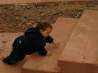
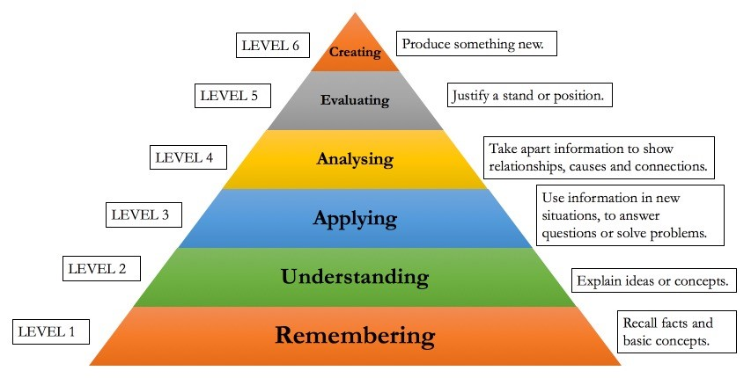
Six Levels of Thinking
Remembering
Understanding
Applying
Analysing
Evaluating
Creating
Notes:
Language helps you to know what specific terms mean, able to help others and make specific use of tools at each level
Stress not all neat and tidy, need basics to develop more complex skills
Overlap and complexity can change ‘level’
Blooms taxonomy, relate to course levels – not rigid
1-6 = critical thinking – the works, includes lateral and creative

Slide 4

Remembering Information
list, name, identify, define, label, describe
Mnemonic – system for improving memory
Acronyms, Acrostics
Use baroque music
Might not ’like’ it –
but it works!**
List: - ooops Liszt
**Music helps access memory
Notes:
Writing often criticised for being overly descriptive not analytical or reflective
Depending on group or workshop aims:
Handout set 1-6
In groups make up a mnemonic from course work

Slide 5

2. Understanding Information
Mind maps (webs)
Key words
Single word
summarise, discuss, distinguish, predict, generalise, categorise
Thinking is the hardest work there is –
That’s why so few people do it – Henry Ford
Notes:
E.g. Summarise strategies #3
3 - interest
2 - like to know more about
1 - tell others about

Slide 6

3. Applying Information
Problem solving
Testing learning in the ‘real world’ or in class activities
apply, demonstrate, examine, solve
What we have to learn to do, we learn by doing
- Aristotle (this includes CT!!)
Notes:
Not focus for this session
Talk it through – examine it
Underline important points
Generate ideas
Decide - consider consequences
Implement – try it
Evaluate solution – did it work
Review – better way?

Slide 7
4 Analysing Information
Breaking it down
Fact v. opinion
Reasoned judgement
Logical thinking
Activity - PMI
analyse, explain, compare, classify
See Alec Fisher
Lots of activities to build arguments and reasoning

Slide 8

5 Evaluating or Criticising Decisions
Objective
Open-minded, flexible
Check assumptions
Check bias
NB first response system
assess, recommend, compare/contrast, conclude, justify
Questions are the active acts of intelligence
- Frank Kingdom
Notes:
Alec Fisher
Judge, justify, compare and contrast, good/bad, work/doesn’t work, problems/solutions
Who benefits, who misses out
Link to critical theory, power analysis, social justice

Slide 9
6 Synthesising or Creating Information
New ideas - Creativity
New applications of ‘old’ ideas
Lateral thinking e.g.
design, invent, rewrite, rearrange
See de Bono
Countless ideas: lateral thinking
Nothing can happen unless you first dream
Carl Sandburgh
Notes:
De Bono
Creativity in higher level HE work

Slide 10
SKILFUL ANALYSIS AND EVALUATION OF DECISONS ‘Thinking Map’: Analysis (Recap)
What are the main Conclusions: may be recommendations/explanations, Conclusion indicator words and ‘therefore’ test may help
What are the Reasons : data, evidence
What is Assumed ; i.e. implicit or taken for granted, perhaps in the Context
Clarify the Meaning (claims or arguments) as needed
(Fisher, 2001)

Slide 11
Thinking Map: Evaluation
Are the reasons Acceptable – this may involve evaluating factual claims, definitions and value judgements and judging the Credibility of a source
(a) Does the reasoning Support its conclusions: is the support strong, e.g. ‘beyond reasonable doubt’, or weak
(b) Are there Other Relevant Considerations/ Arguments which strengthen or weaken the case
7. This Evaluation can help provide sound justification
(Fisher, 2001)

Slide 12
Evaluating
With skills in evaluating, you are able to judge, check, and even critique the value of material for a given purpose.
At this level in TAFE you should be able to think critically. Your understanding of a concept or discipline should be sound. You should be able to present and defend your opinions.
Examples include: judge · assess · compare · evaluate · conclude · measure · deduce · argue · decide · choose · rate · select · estimate · validate · consider · appraise · value · criticise · infer

Slide 13
Problem Solving using an Oganiser
Look at the Problem Solving Oganiser on p.7 of AT02
Think / brainstorm a problem that an IT company may face
Either in pairs or as a class, use steps 1 – 5 to choose the best solution
Once completed, discuss the CT methods you used
Read AT02 Task 2 and individually start using the organiser to generate solutions for the scenario

Slide 14
In these sessions we looked at:
The Six Levels of Thinking – Remembering, Understanding, Applying, Analysing, Evaluating, Synthesising
Evaluating and justifying decisions
Problem Solving using an Oganiser
Start AT02 Task 2

Slide 15
Further Reading, Activities and Assessments
Open the Workbook and read pages 73 – 90
Complete Activities 11 & 12 in Workbook (individually or as a class)
Continue AT02 assessment questions 11 & 12
Commence AT02 Task 2

